Slide 1
Wider determinants of health
NU/DT5079
‘No injustice is greater than the inequalities in health that scar our nation’
(DH, 2000)
Dr. Hilda Mulrooney,
Reader in Nutrition & Health

Slide 2
Key points we will cover:
Health inequalities: what they are & how they relate to disease
Wider/social determinants of health

Slide 3
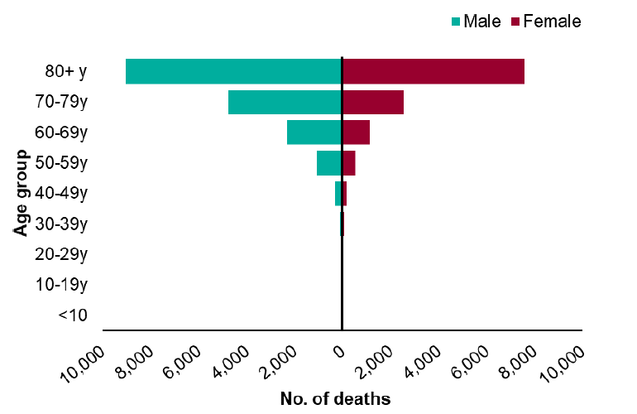
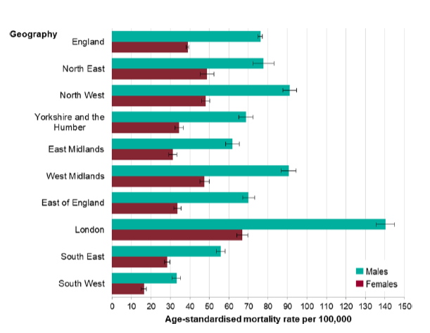
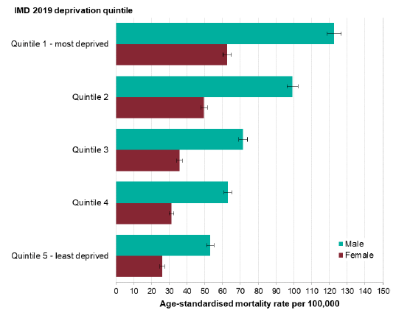
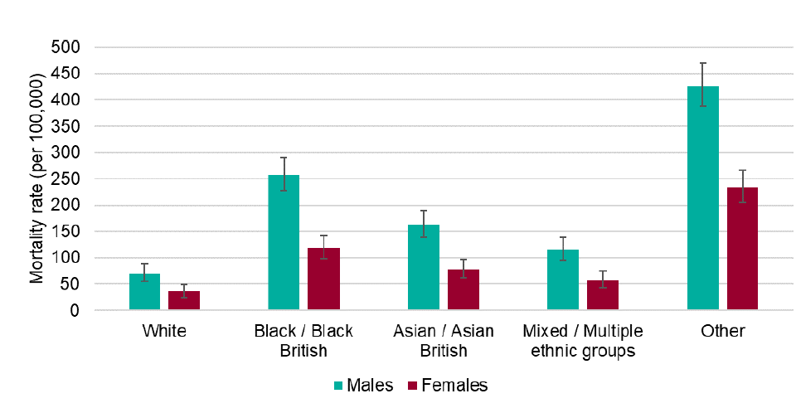
Covid 19 deaths by….
Place
Age
Deprivation
Ethnicity
(PHE, 2020)

Slide 4
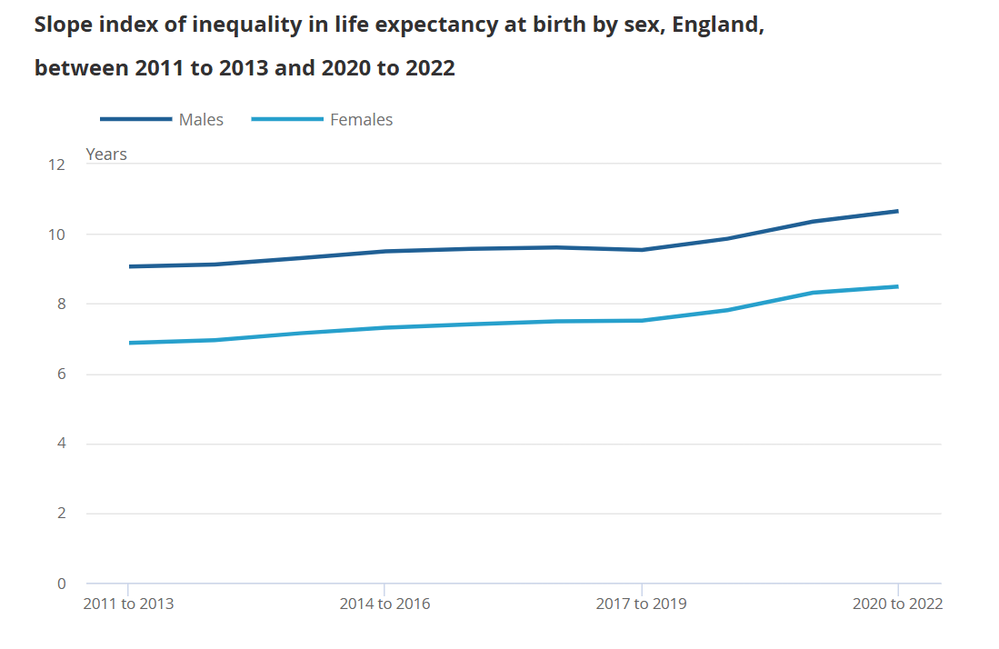
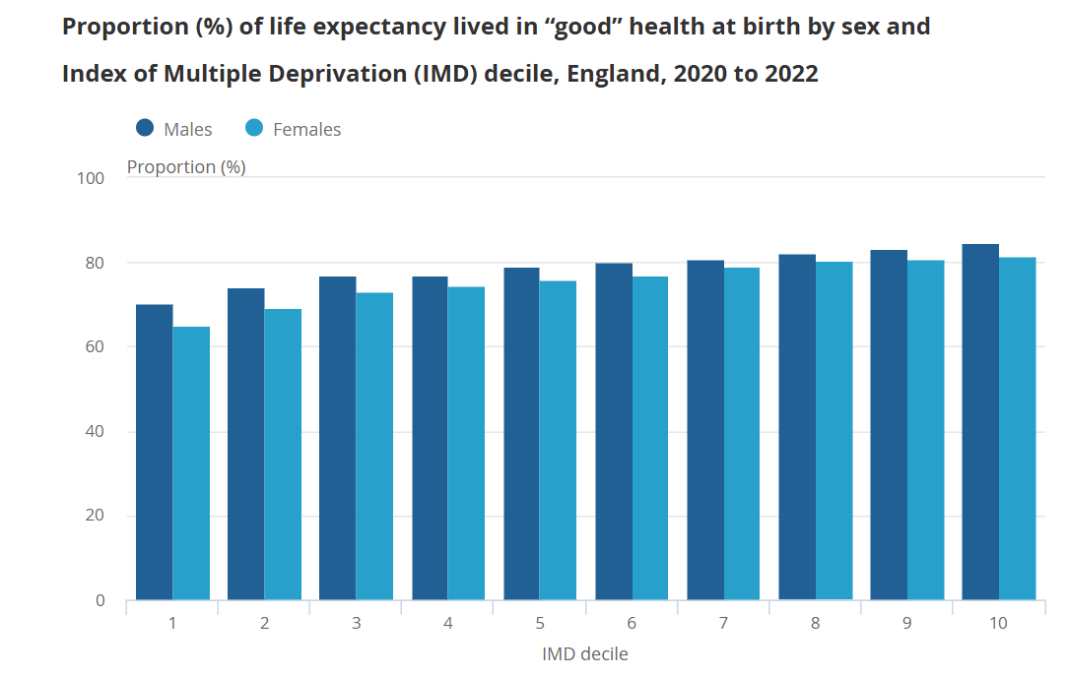
Inequalities reduce life expectancy & disability-free life expectancy
(ONS, 2025)

Slide 5
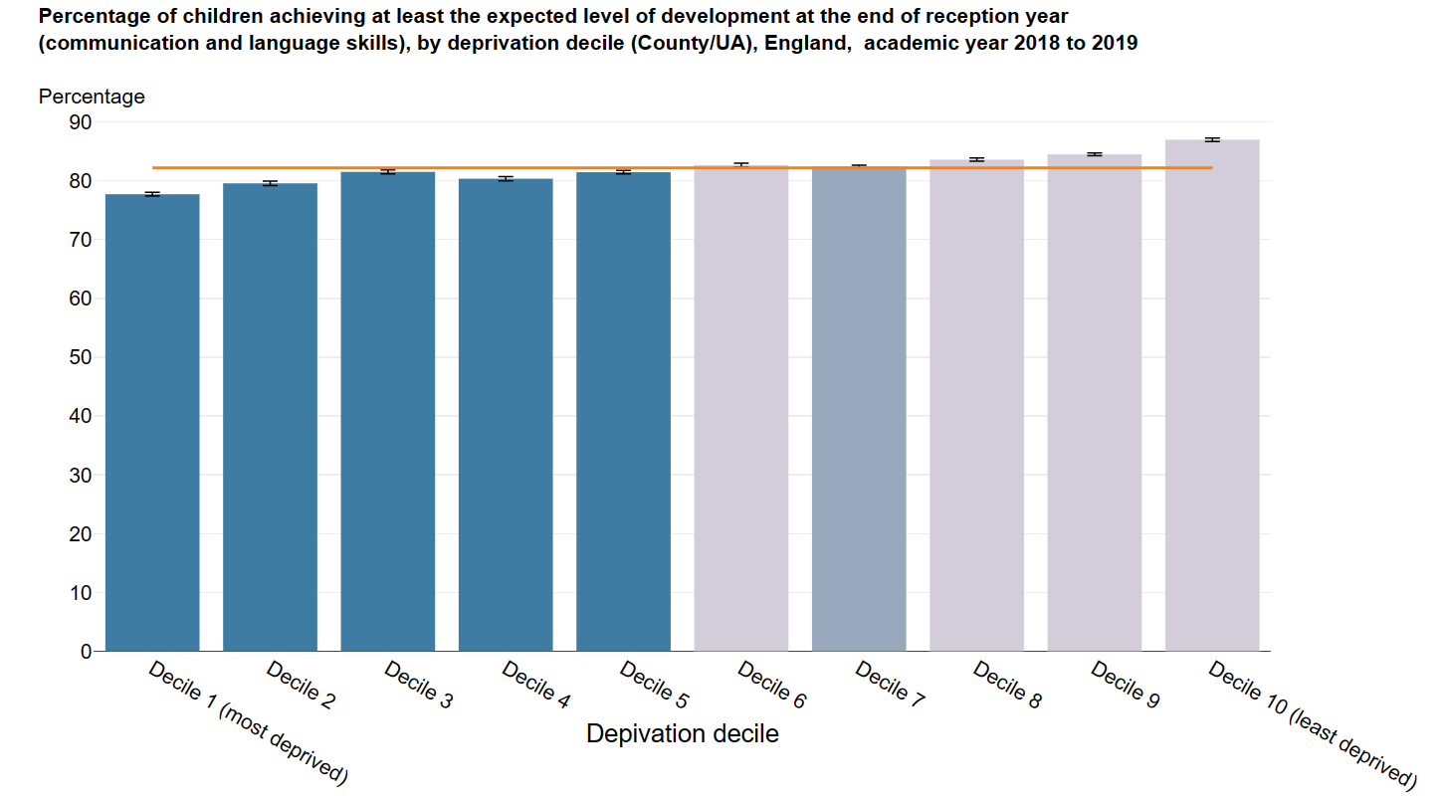
Early years educational outcomes by deprivation decile
(PHE, 2021)

Slide 6
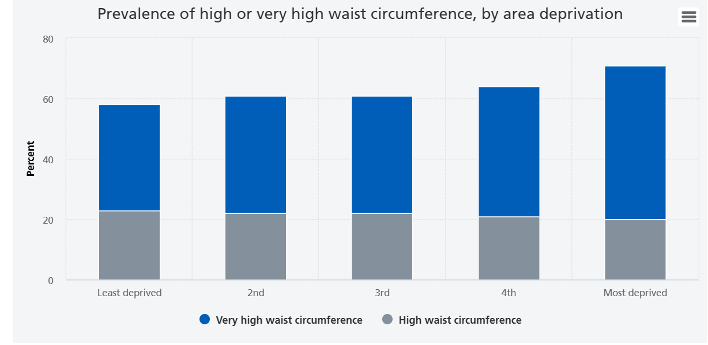
Adult waist circumference, England
(NHS Digital, 2024)

Slide 7
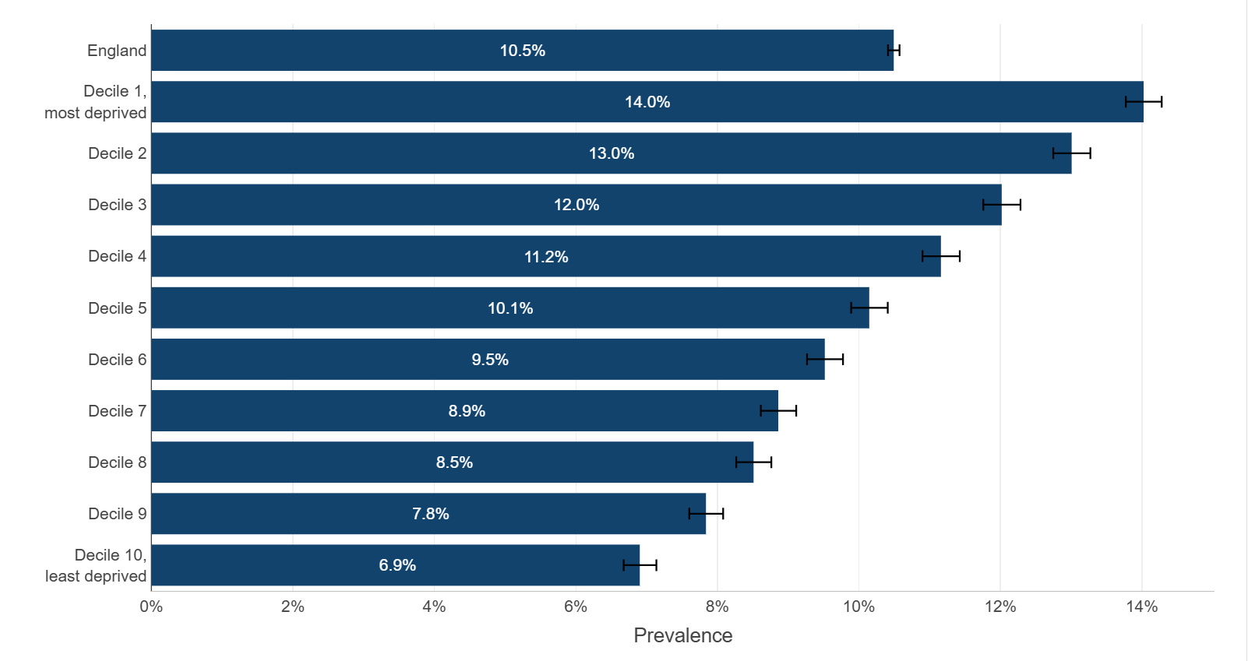
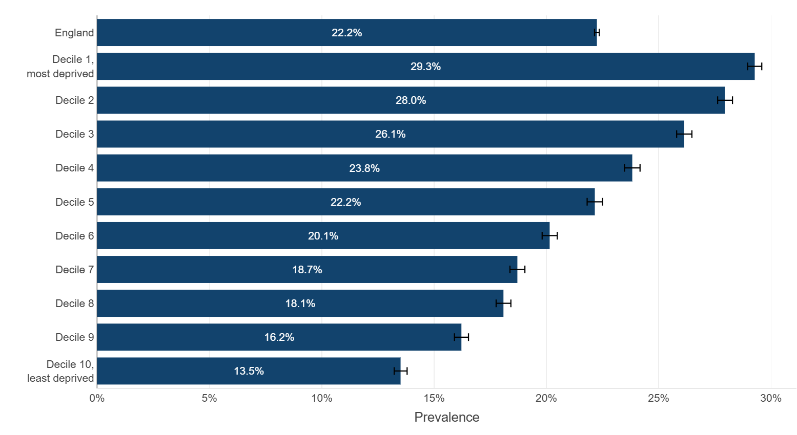
Obesity prevalence by deprivation decile in a) Reception & b) Year 6 children in 2024/5 school year
a)
b)
(DHSC, 2025)

Slide 8
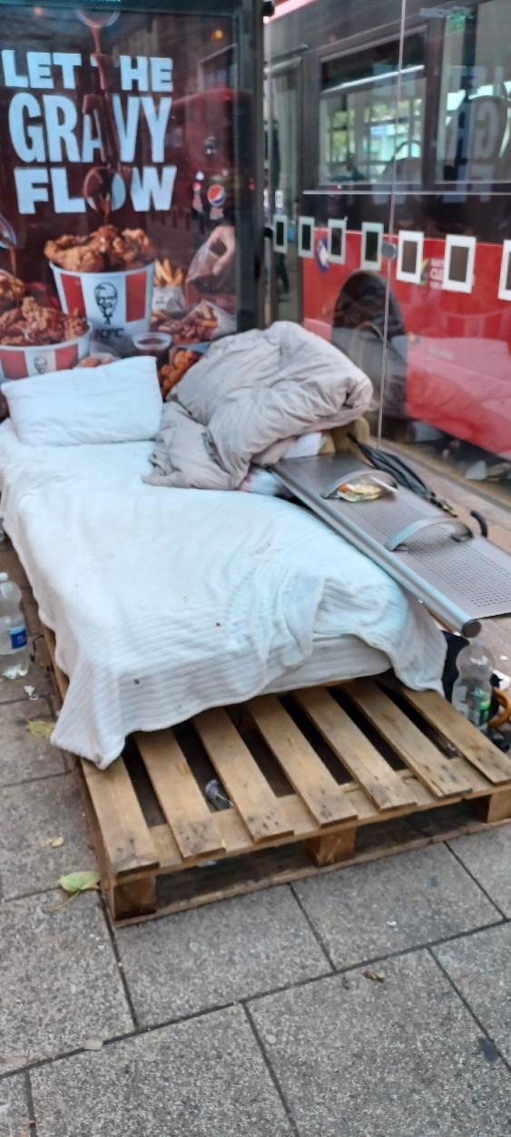
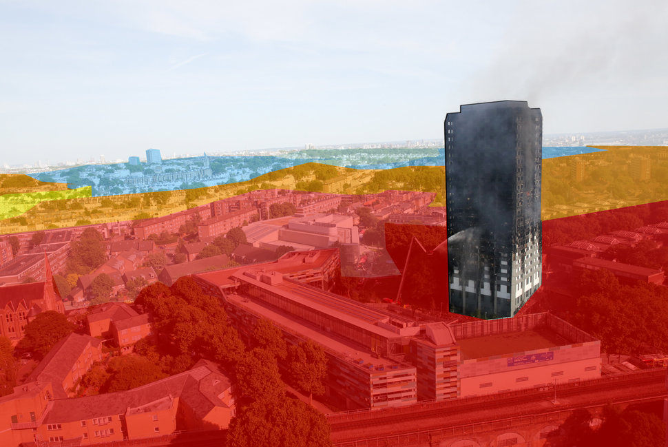
Grenfell Tower: in most deprived 30% for health deprivation & disability
Notting Hill: in least deprived 10% for health deprivation & disability
http://www.huffingtonpost.co.uk/entry/grenfell-tower-tale-two-kensingtons-borough-extreme-rich-poor_uk_594269e9e4b003d5948d5116

Slide 9
‘The fact that in England today people in different social circumstances experience avoidable differences in health, well-being & length of life is, quite simply, unfair.
Creating a fairer society is fundamental to improving the health of the whole population & ensuring a fairer distribution of good health’
(The Marmot Review, 2010)
Build back fairer Marmot review (2020): https://www.health.org.uk/reports-and-analysis/reports/build-back-fairer-the-covid-19-marmot-review
Fuel poverty Marmot review (2022): https://www.instituteofhealthequity.org/resources-reports/fuel-poverty-cold-homes-and-health-inequalities-in-the-uk/read-the-report.pdf
Feed the Future campaign | Food Foundation

Slide 10
What are the wider determinants of health?
Factors which shape the conditions in which we live
Diverse: social, economic , political, environmental, & cultural factors
Influence people’s mental and physical health Systematic variation in these factors constitutes social inequality, an important driver of health inequalities
Is obesity really the new smoking?
http://www.bbc.co.uk/programmes/p047t7v6

Slide 11
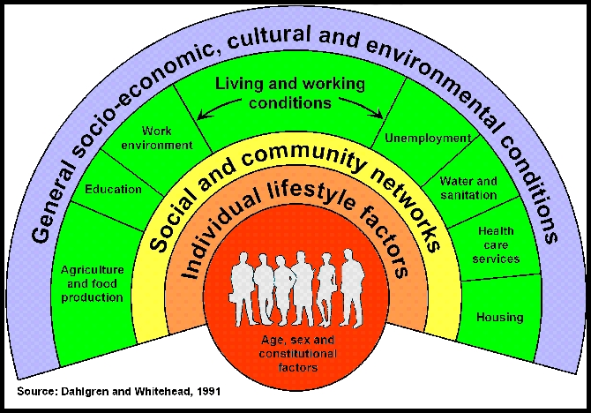
‘What has been spoiled through man’s fault can be made good again through man’s work’
I-Ching (Book of Changes)

Slide 12
Social gradient
Stress
Early life
Social exclusion
Work
Unemployment
Social support
Addiction
Food
Transport (WHO, 2003)
Wider determinants of health
https://www.youtube.com/watch?v=3hSQBwBndR8 Housing crisis (3m)
https://www.bbc.co.uk/sounds/play/m0019k6y Food Poverty podcast (29m)
Long read King’s Fund: https://www.kingsfund.org.uk/insight-and-analysis/long-reads/forecasted-doubling-health-care-spending

Slide 13
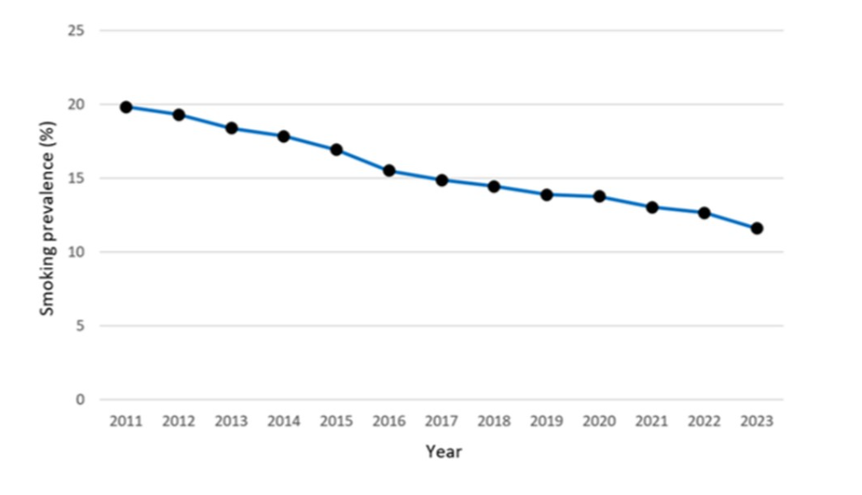
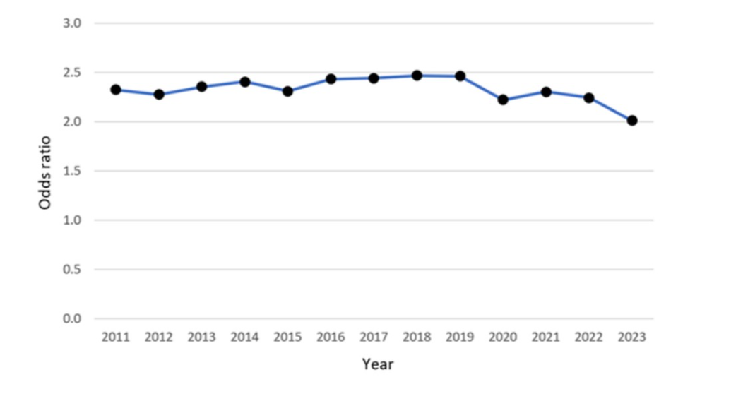
Current smokers, England, adults, 2011-2023
OR of smoking in routine & manual labour group compared with others, England, adults, 2011-2023
(OHID, 2024)

Slide 14
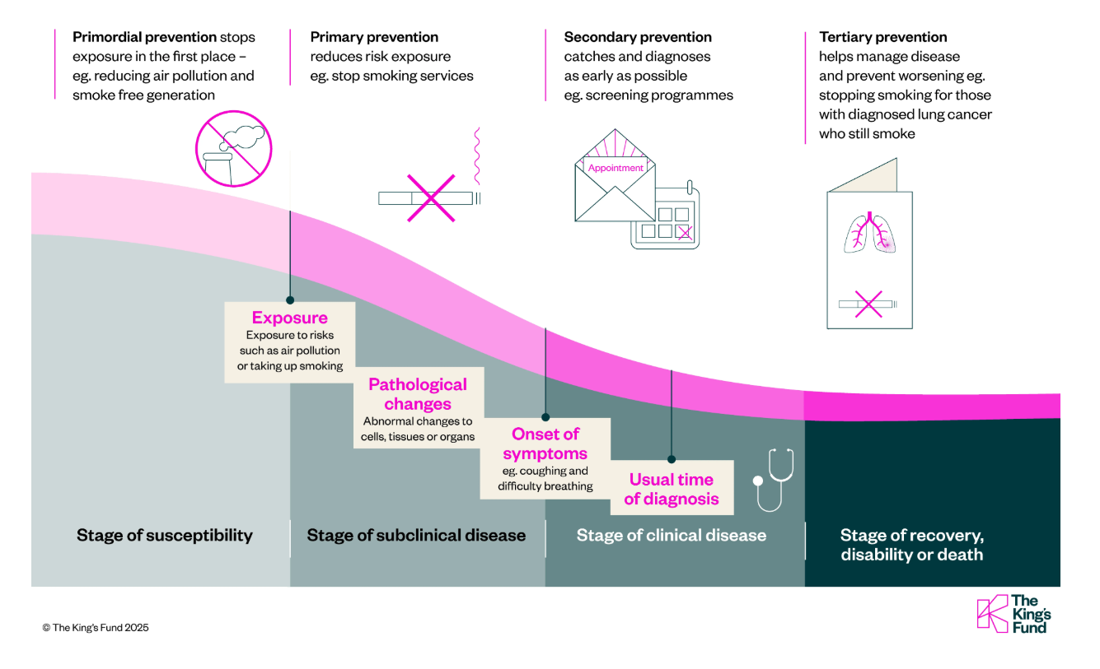
Examples of prevention types for lung cancer
(Arnold & Holden, 2025)

Slide 15
Stopping smoking more difficult for disadvantaged groups
Lack of social support
Higher nicotine dependency
Challenging life circumstances
Factors relating to the services themselves
(Hiscock & Bauld, 2025)

Slide 16

Overlap with UN Sustainable Development Goals (SDGs)
https://sdgs.un.org/goals

Slide 17
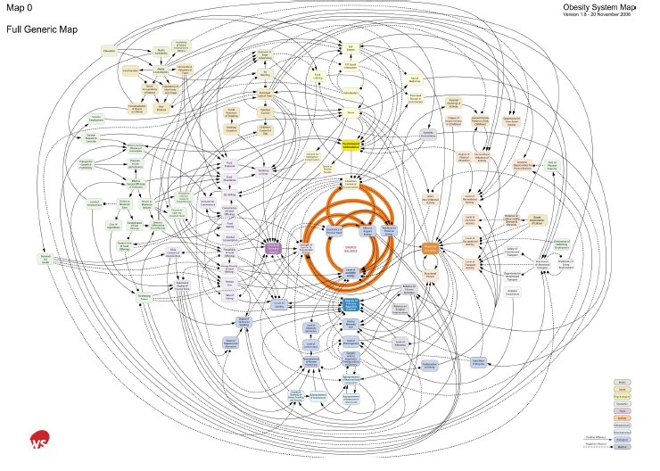
Very complex….
‘Inevitable & largely involuntary consequence’
(Butland et al, 2007: www.foresight.gov.uk)

Slide 18
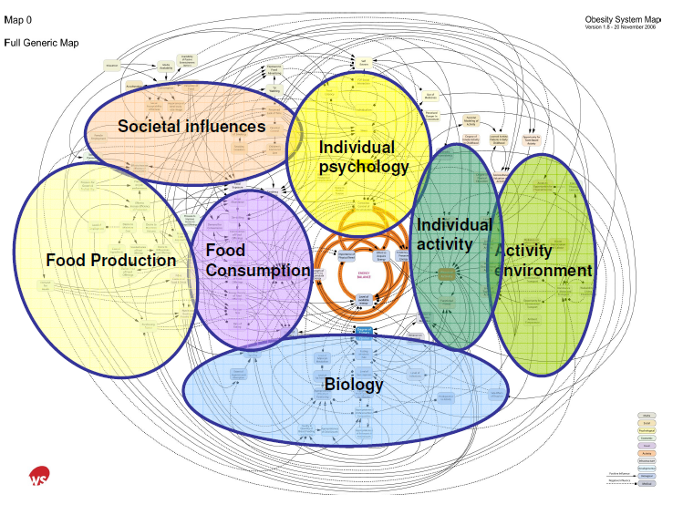
‘Complex web of environmental, physiological & behavioural factors’
(Butland et al, 2007: www.foresight.gov.uk)

Slide 19
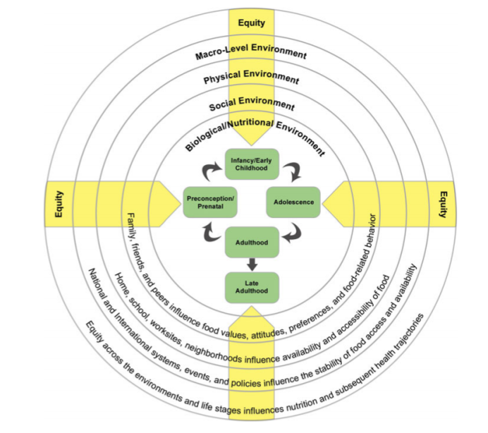
Access to opportunities, resources, support
(Herman et al, 2014)

Slide 20
Reaching some groups is more challenging…
Marginalised groups, hard to hear, seldom heard groups of people
Homeless, refugees, travelling communities, learning disabilities
Older people, those not speaking/reading English, offenders
Lack of awareness of opportunities
Impairment/inaccessibility
Cultural differences: age, gender, timing, locations
Expectations
Trust
Time

Slide 21
Questions to ask:
How can I engage the target population?
What will help & hinder?
What will support them?
Helpful workbook: https://lmcp.co.uk/wp-content/uploads/2017/03/Hard-to-reach-workbook.pdf

Slide 22
References
Arnold S & Holden J (2025) What is prevention in health? King’s Fund long read. https://www.kingsfund.org.uk/insight-and-analysis/long-reads/what-is-prevention-in-health
Butland B et al (2007) Tackling Obesities: Future Choices. Project Report. Foresight: London.
DH (2000) NHS Plan: A Plan for investment, a plan for reform. https://www.bsuh.nhs.uk/library/wp-content/uploads/sites/8/2020/09/The-NHS-plan-2000.pdf
DHSC (2025) National Child Measurement Programme annual report, academic year 2024 to 2025. https://fingertips.phe.org.uk/static-reports/obesity-physical-activity-nutrition/national-child-measurement-programme-2024-2025-academic-year.html
Herman DR et al (2014) Life Course Perspective: Evidence for the Role of Nutrition. Matern. Child Health J 18: 450-61.
Hiscock R & Bauld L (2025) Stop Smoking Services and Health Inequalities. NCSCT Briefing 10. https://www.ncsct.co.uk/library/view/pdf/stop-smoking-services-and-health-inequalities.pdf
Marmot M (2010) Fair Society, Healthy Lives. https://www.local.gov.uk/marmot-review-report-fair-society-healthy-lives
Marmot M et al (2020). Build Back Fairer: The COVID-19 Marmot Review. The Pandemic, Socioeconomic and Health Inequalities in England. London: Institute of Health Equity. Executive summary. https://www.health.org.uk/sites/default/files/2020-12/Build-back-fairer--Exec-summary.pdf

Slide 23
NHS Digital (2024) Health Survey for England 2022 Part 2. https://digital.nhs.uk/data-and-information/publications/statistical/health-survey-for-england/2022-part-2/adult-overweight-and-obesity
OHID (2024) Smoking profile for England: statistical commentary, October 2024 update. https://www.gov.uk/government/statistics/smoking-profile-october-2024-update/smoking-profile-for-england-statistical-commentary-october-2024-update
ONS (2025) Healthy life expectancy by national area deprivation, England and Wales: between 2013 to 2015 and 2020 to 2022. https://www.ons.gov.uk/peoplepopulationandcommunity/healthandsocialcare/healthinequalities/bulletins/healthylifeexpectancybynationalareadeprivationenglandandwales/between2013to2015and2020to2022
PHE (2021) Health profile for England 2021.
https://fingertips.phe.org.uk/static-reports/health-profile-for-england/hpfe_report.html
PHE (2020) Disparities in the risk & outcomes of Covid 19. https://assets.publishing.service.gov.uk/government/uploads/system/uploads/attachment_data/file/908434/Disparities_in_the_risk_and_outcomes_of_COVID_August_2020_update.pdf
WHO (2003) Social Determinants of Health, the Solids Facts, 2nd edition. https://apps.who.int/iris/bitstream/handle/10665/108082/9289012870-eng.pdf?sequence=1&isAllowed=y
Useful information:
https://www.health.org.uk/
https://fingertips.phe.org.uk/profile/wider-determinants

